Slide 1
RAS Friday 3/20/15
GMAS Update
Andrew Malone andrew_malone@harvard.edu

Slide 2
Agenda
GMAS April 2015 Release Overview
GMAS 2.0 Updates
Notes:
2

Slide 3
GMAS April 2015 Release (4/20/2015)
This release includes two major bodies of work:
Technology conversion
Important infrastructural work that enables GMAS 2.0 and significantly improves performance (sneak peak on the next slide!)
Integration between GMAS and HMS’s COI Huron system (OAR)
Similar to the integration between GMAS and FCOI
Designed to remove the current paper-based, cumbersome process
Notes:
3

Slide 4
GMAS April ’15 Release
Performance Improvements

Slide 5
GMAS 2.0 Project Updates
The GMAS 2.0 implementation phase has been funded!
Completed user research and prioritization of themes
Developed technical proof of concept
Begun building toolbox, admin module pages
Hired and onboarded resources
Starting to build out new GMAS 2.0 components and screens
Notes:
5

Slide 6
Research Participants

Slide 7
Research Participants

Slide 8
GMAS 2.0
User Research Themes
The following themes were collected during the user research phase including focus groups, interviews, and input from the GMAS 2.0 Business Steering Committee
Themes
1. Too Many Clicks / Digging for Information | 14. GMAS Email Notifications Are Often Ignored
2. Documents Are Hard To Find | 15. Users Often Switch Between Accounts and Dates and Dollars Views
3. Post-Award Projections Calculated in Spreadsheets & Encumbrances | 16. Request for Proposal / Award Management Reporting
4. Frequent Communication Outside of GMAS | 17. Difficulty Searching for Information
5. Creating New Proposals is Unwieldy | 18. Reconciliation & Closeout
6. Current GMAS Training is Mostly Introductory | 19. Enhanced Sponsor Information
7. Missing Request Types Require Manual Workarounds | 20. Data Integrity / Discipline Information
8. Cost Sharing Is Used Inconsistently and Hard To Monitor | 21. Cost Transfers
9. Some Departments Avoid Using S2S | 22. Add / Improve Dashboards (Requests in Process, Sub-agreements, etc.)
10. Budget Entry (Budget Information Needs to be Entered in Multiple Places) | 23. Project Grouping – see projects on one screen (list, dates)
11. Approvals Require Manual Checking | 24. Equipment (gov’t tracking, and reporting)
12. Hard to See a List of GMAS Tasks I Need to Complete | 25. Sub-Recipient Monitoring
13. Interdisciplinary / Interfaculty Projects
GMAS 2.0 Business Steering Committee Chairs: Cathy Breen, OSP and Frank Urso, HSPH
FAS/SEAS reps: Geoff Tierney (OEB) and Elizabeth Lennox (RAS), Nadija Mujagic (SEAS)

Slide 9
GMAS 2.0 Prioritization Exercise Results
Team to focus on the top 5

Slide 10
GMAS 2.0
Straight Convert Track Goals
Technology Goals:
Update the technology used in the presentation layer to be more modern and flexible
Provide ability to update the interface iteratively across the application
Build new pages and features faster
Modern industry standard framework and current best practices
Update page templates for an improved user interface
What does this mean for GMAS users?
Pages are less dense
Use of spacing, type and color creates a page that is easier to look at for long periods of time, and establishes a visual hierarchy that makes it easy to understand what information is important.

Slide 11
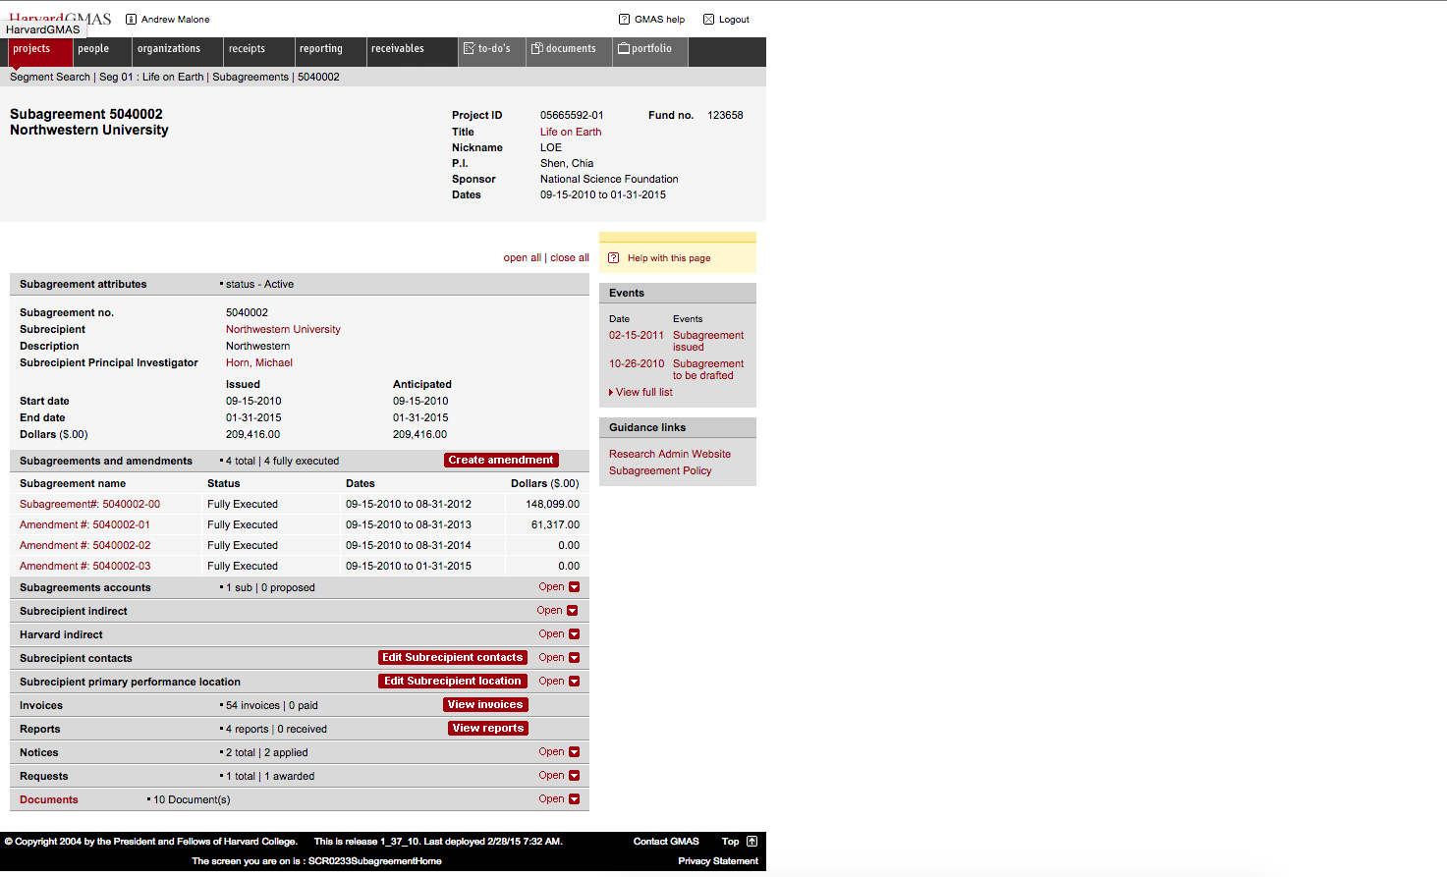
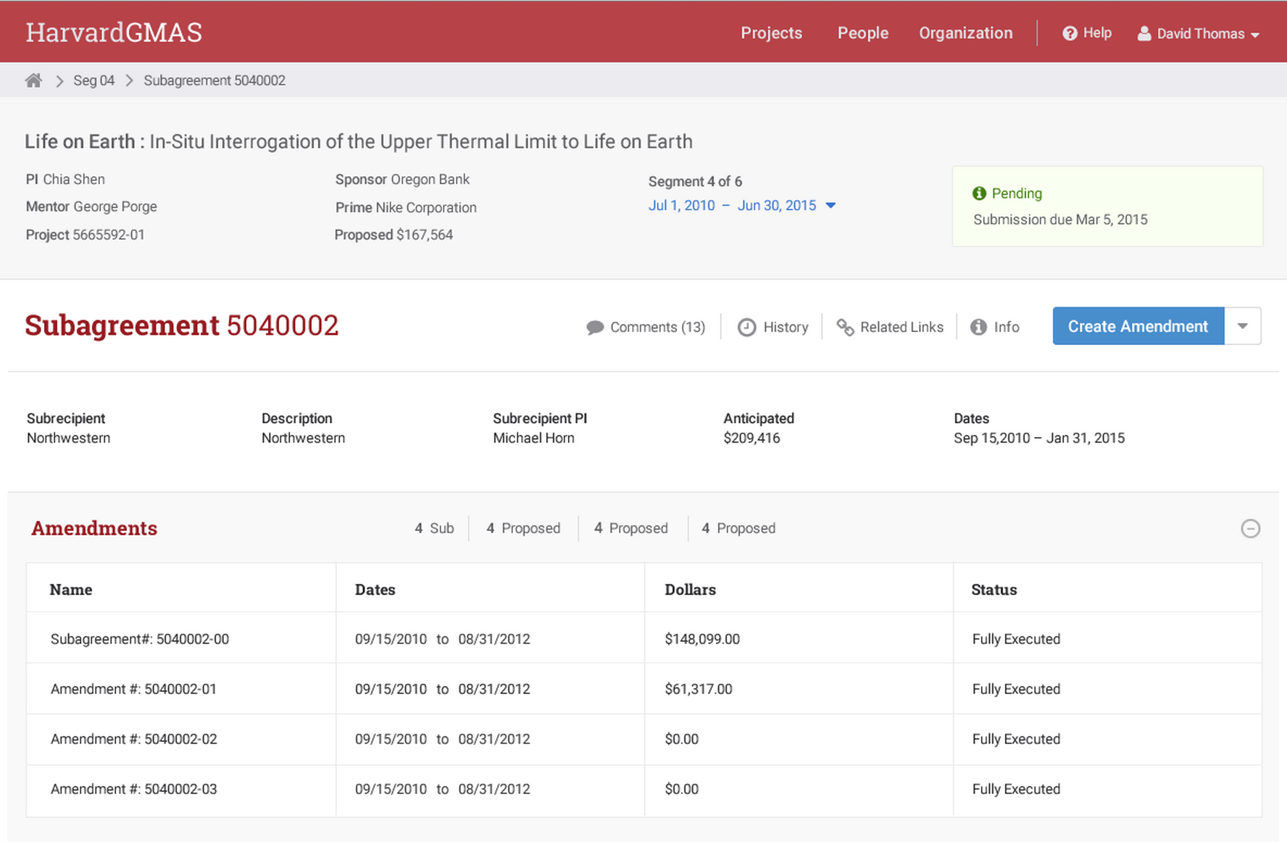
Original GMAS
GMAS 2.0 Converted Page

Slide 12
GMAS 2.0 Implementation Phase High Level Timeline
Major Milestones | FY15 |  |  |  |  |  | FY16
 | Jan | Feb | March | April | May | June | July | Aug | Sep | Oct | Nov | Dec | Jan | Feb | March | April | May | June
Straight Convert Track Foundational Work Page Build/Test
Functional Retirement
Quick Wins/Small Fixes
Design Development
Business Priorities: 1. Streamlined Navigation 2. Documents 3. Budget Entry
Release 38 - JPA/COI
Release 39
Some Straight Convert Pages
65%
Percentage of work completed
Percentage of work not completed
Work not started

Slide 13
Next Steps
Continue onboarding staff (in FSS and HUIT)
Build product roadmap, project and resource plans
Continue design and technical work on Convert track
Defining and designing enhancements for #1 Priority (Streamline Navigation)
Kick off Security track
Kick off Training track
Start developing project communication (ex. website)
Complete April ’15 GMAS release
Notes:
13

Slide 14
Q + A

