Slide 1
FDP Expanded Clearinghouse Pilot
(not the FDP FCOI Clearinghouse)

Slide 2
What is it?
Federal Demonstration Partnership Pilot
Reduce administrative burden around subrecipient monitoring
Collect data to persuade broader reform of subrecipient monitoring

Slide 3
How does it affect you?
Still in flux, but …
If we are a subrecipient, the prime recipient can review our entity record to obtain institutional information.
You can obtain and/or verify institutional information from a proposed subrecipient.

Slide 4
Sure thing. Now show me.
Go to: http://thefdp.org
Select the FDP EXPANDED CLEARINGHOUSE link,
Select List of Pilot Institutions link,
Find the institution and click on the name.

Slide 6
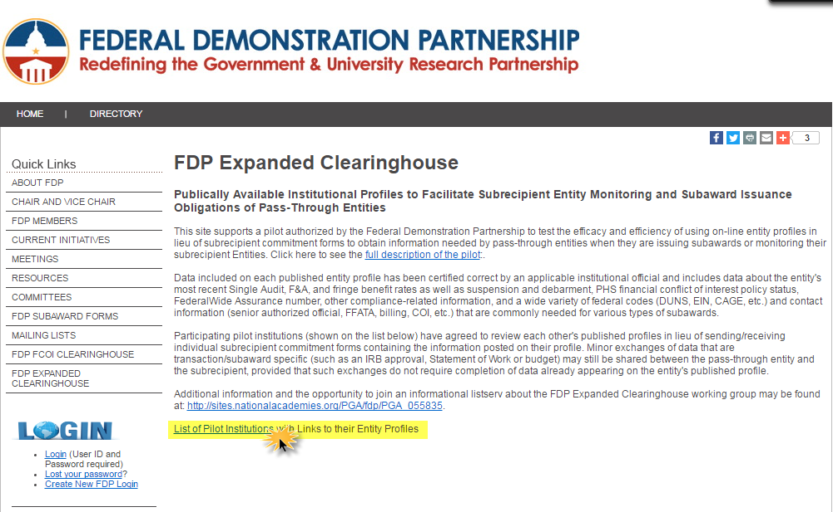

Slide 7
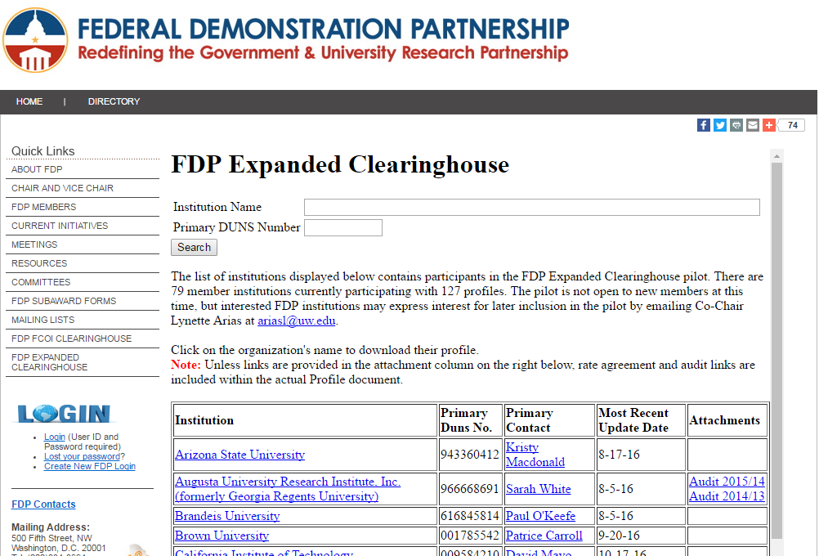

Slide 8
Remember, some institutions have multiple sites

Slide 9
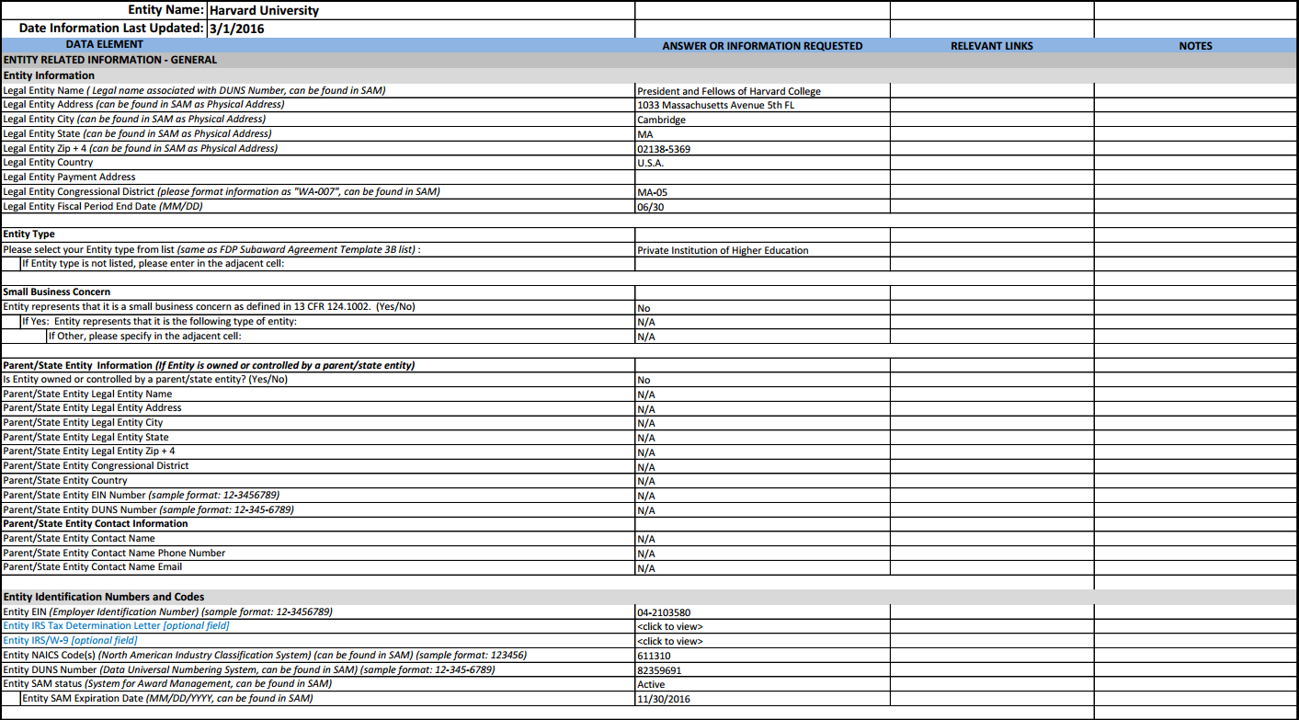

Slide 10
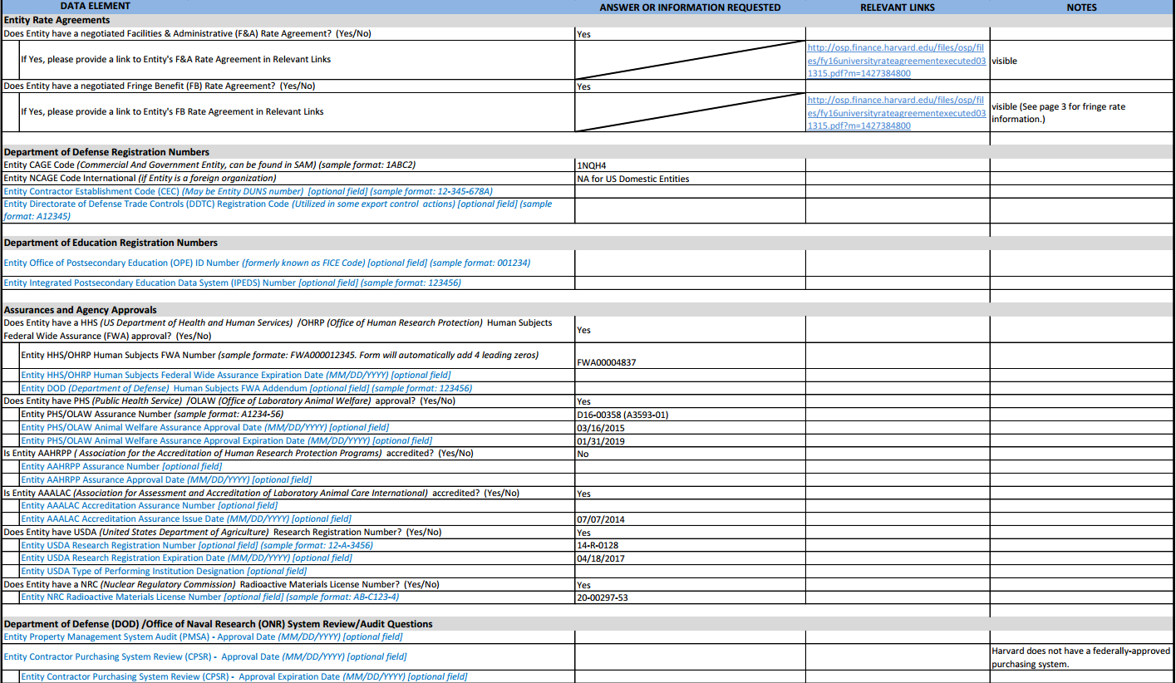

Slide 11
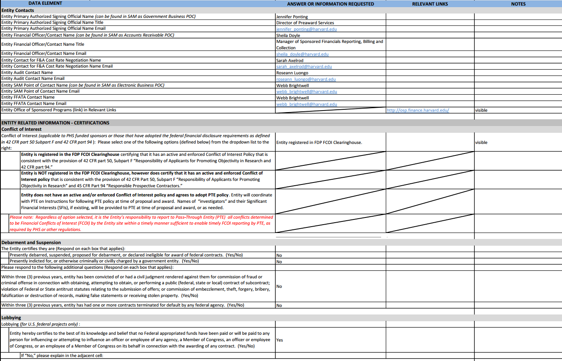

Slide 12
