Slide 1
F&A
Facilities and Administrative Costs
May 19, 2017
Office for Sponsored Programs
Cost Analysis Team

Slide 2
The History And Evolution of F&A Cost Rates
1947 ONR reimbursed universities for “institutional” (indirect) costs incurred for Navy contracts.
1955 DHEW used this approach to set their rate at 8% of
Total Direct Costs (still maximum for Training Grants)
1958 General rate of 15% for NIH fixed by law; increased to 20% in ’63
Bureau of the Budget (now OMB) issues Circular A-21
1966 Government makes a commitment to “fully reimburse”
universities for the cost of federally sponsored research
1979 A-21 major revision introduced the concept of MTDC (instead of salaries and wages)
1986 A-21 revision capped faculty administration costs @ 3.6%
(allowance) establishing a precedent for capping a portion of F&A
1991 A-21 revision caps administrative components (GA,DA,SPA) @ 26%

Slide 3
The History And Evolution of F&A Cost Rates (CONTINUED)
1993 A-21 revision retains the 26% cap, adds the student services component to the cap, & establishes requirement for university research & clerical and administrative charging
1996 A-21 revision introduced Cost Accounting Standards (CAS), raises the equipment threshold from $500 to $5,000, changes the term “indirect costs” to “facilities and administrative costs”
1998 Revision June 1, 1998 Various revisions include establishing a review process to ensure reasonableness of facility costs
2000 Revision introduces a standard format for the submission of F&A proposals, including a listing of required data elements
2004 Revision makes A-21 consistent with some provisions of other OMB circulars. SSFs rates to be reviewed and adjusted at least biennially
2014 Major revisions/consolidation of eight OMB Circulars - – 2CFR200 published,
referred to as the Uniform Guidance (UG)

Slide 4
What is F&A?
DEFINITION 2 CFR 200.56
…costs incurred for common or joint purpose… and not readily assignable…
Indirect costs…must be distributed…base[d on] relative benefits derived.
Notes:
Definitions
A-21
OMB
DHHS/DCA
Cognizant Agency
F&A Rate
MTDC

Slide 5
What is F&A? 2 CFR 200 Appendix III
Direct Costs are incurred in support of Harvard’s major functions, as defined in section A.1.:
a. Instruction (A01)
b. Organized research (A02)
c. Other sponsored activities (A03)
d. Other institutional activities (A04)
All other costs are Indirect Costs. Indirect costs can benefit multiple functions or a single function.

Slide 6
8 Components of F&A Rate 2 CFR 200 Appendix III
Section B.
2. Depreciation (building and equipment)
3. Interest (for debt on buildings and equipment)
4. Operations and Maintenance
5. General Administration and General Expenses *
6. Departmental Administration Expenses *
7. Sponsored Programs Administration *
8. Library Expenses
9. Student Administration and Services *
* Defined as Administrative A in Section C.8. (26% cap). All others are Facilities F.
Notes:
FACILITIES (primarily space related costs):
What does it cost to run and operate the university. All these costs are accumulated and then spread over direct costs
Some space cost are associated with research, some have no association with research, for example, dorms, dining halls
What goes into the space costs
The cost of constructing and renovating bldgs – charged as depreciation
The cost of equipment – also charged as depreciation
Cost to operate the bldgs
Utiliites (heat, electricity, chilled water, etc)
Maintenance/repairs
Custodial/cleaning cost
Rent payments to external landlords
Interest costs (for construction or equipment purchase loans) – Must be external
The costs of the Library are included in the Facilities component

Slide 7
Administrative Costs – why the Cap?
Departmental Administration
Includes departmental costs (including grants managers), school admin costs (deans, local H/R, finance, facility management)
General Administration & General Expense
President & provost offices, most of CADM
Sponsored Projects Administration (SPA)
OSP, part of OTD, OVPR
Student Services
Registrar, Bursar, Student Medical
Notes:
ADMIN Costs – For IHE this is capped at 26%
These costs are broken down into specific categories:
Departmental Administration (DA) – Local dept’l costs including:
Grant managers
Admin staff
Admin supplies
Costs associated with proposal preparation
General Admin (GA) –University or School based admin (HMS vs. Univ)
All central functions (Procurement, A/P, payroll, central H/R, benefits office, Treasury, Budget office, etc)
President and Provost offices
Sponsored Programs Costs
OSP
SPA offices
FAS RAS
Parts of OTD
Student Services (none of this will be a part of the research indirect cost rate)

Slide 8
Calculation of F&A Rate
8
Indirect Costs Benefitting Research
Direct Costs of Research (MTDC)
= F&A Rate
Research grant expenses
Over expenditures
Committed
Cost Sharing
University-funded competitive awards
Notes:
Theoretically this is simple: A numerator (top number) of all the indirect costs associated with research and a denominator (bottom number – also called “the base”) – all the direct costs associated with research.
All indirect costs divided by all direct costs
What makes it so complicated?
The indirect costs have to be spread over the various categories of direct costs
Some are easy and some are complicated.
The registrar’s office and dorms are easy
The library, controller’s office and h/r are much harder
And direct costs have 2 complications
Only MTDC (modified total direct costs get include in the direct cost base) - we’ll get into this on the next slide
Not just research grant expenses go in the OR base – Other items include
Cost sharing
Any university funded research the is “competitively awarded and separately funded and accounted for”
Over expenditures

Slide 9
9

Slide 10
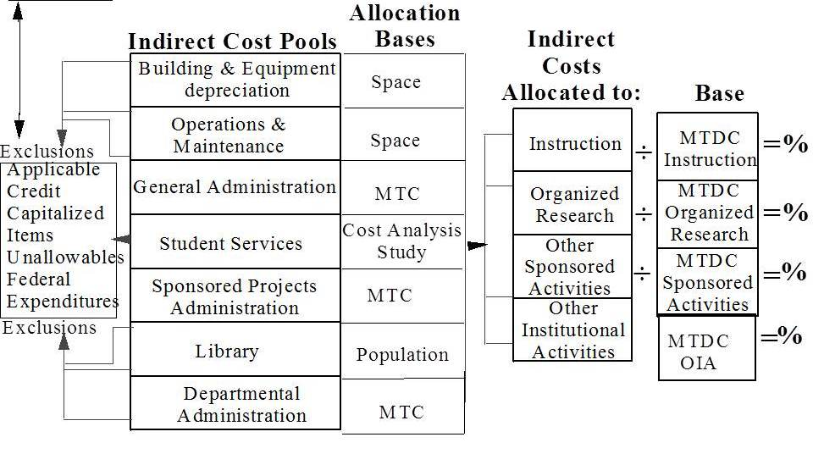
Calculation of F&A Rate
10
Audited
Financials

Slide 11
Harvard’s F&A Rate Structure
Rates through June 30, 2019: | Research On-campus | Research Off-campus | Other Sponsored Activities
Harvard School of Public Health | FY17 58.5% FY18 59.0% FY19 59.5% | 26.0% | 45.0%
University Area | 69.0% | 26.0% | 34.0%
Wyss Institute - LMA | 88.5% | - | -
Harvard Medical School | 69.5% | 26.0% | 38.0%
Notes:
Harvard is slightly unique in having 3 rate areas
HMS
SPH
University Area (the Cambridge campus which includes the contiguous space across the river, all non-Longwood space)
Why do you think the SPH rate is lower than the HMS rate?
All 3 schools are at the 26% cap for admin costs
It is the facilities cost that drives the rate.
Note that there are a set of 3 rates for each rate area. We’ll address the off campus rates and OSA in this presentation.

Slide 12
Base Year Concerns (FY 2018)
Planning for 2018 now. FAS RAS and OSP are working together on a Dry Run using 2016 expenses and 2014 space data.
The characterization of Activities as Instruction (IDR A01) v. Organized Research (OR A02) v. Other Sponsored Activity (OSA A03), particularly on less-than-full IDC awards
2 CFR 200.87 Research – systematic study for a fuller knowledge or understanding
2 CFR 200 Appendix III Section A.1.b. Organized – separately budgeted and accounted for

Slide 13
Base Year Concerns (FY 2018) (continued)
The characterization of on campus v. off campus
From Rate Agreement
The University uses the rate applicable to the location where the preponderance of the time and effort will be expended. Accordingly, each contract or grant is assigned only one indirect cost rate.
The off-campus rates apply to effort conducted on premises not owned by the University at a location sufficiently far removed from campus to prohibit the normal use of University facilities and services

Slide 14
Base Year Concerns (FY 2018) (continued)
Use of the “ineligible for federal reimbursement” object codes (845x range) for non-sponsored expenses
Vigilance about location and “in use” status of equipment
Inclusion of root values on facilities-related expenses
Participation and cooperation during the Space Survey

Slide 15
OSP Cost Analysis Team
Jonathan Dutt – jonathan_dutt@harvard.edu (617) 496-2702
Peggy Mui – peggy_mui@harvard.edu (617) 496-4771
Mark (William) O’Brien – mark_w_obrien@harvard.edu (617) 496-2506
Judith (Ann) Ryan – judith_ryan@harvard.edu (617) 496-9047

