Slide 1
Concur
FAS Overview
RAS Friday
FAS Administrative Operations
January 19, 2017

Slide 2
Agenda
Project Overview
Project Scope and Assumptions
Federal Sponsored Business Rules
Identified Challenges
Next Steps

Slide 3
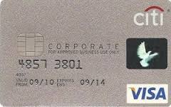
Project Overview
Objective
Replace the current Web Reimbursement system with a new, online tool for submitting and processing employee reimbursements and authorized purchases on Citibank Corporate Cards
Key Features:
 | Mobility: Users can take pictures of receipts, create and submit expense reports, review and approve reports from a mobile device
 | Credit Card Integration: Citibank corporate credit card charges are imported directly into Concur. Foreign transactions are converted to USD as part of the interface
 | Online Processing: Users can prepare, submit and approve reports entirely online eliminating the current paper-based workflow.
For more information: http://travel.harvard.edu/concur

Slide 4
Project Scope
Implementation Scope
Concur Expense Reimbursement module
Payments made out of Concur
Integration with existing systems
PeopleSoft: Employee data
Oracle: Expense accounting information & updates to GL
Citibank: Credit card transactions & payments
Set up of business rules, approval hierarchies, expense policies and expense types
Out of Scope
Purchasing Cards (PCARD)
BCD Travel

Slide 5
High Level Project Timeline
Oct - Dec 2015
Jan - Jun 2016
Aug 2016
Nov 2016
Jan 2017
Mar 2017
Planning
Pilot
Wave 1
Wave 2
Wave 3
Wave 4
Project Setup
Governance Structure
Requirements gathering
As-is and to-be process design
Change Management Strategy
System configuration based on business rules
Development of inbound and outbound interfaces
PeopleSoft
Oracle
Citibank
Testing
Training
Rollout to Pilot Schools
HBS & GSE
Athletics
Celtic
DCE (David Malan’s team)
GSAS
Music
Philosophy
Office of the Arts
Slavic
Admin & Finance
Admin Ops
HR
Finance
MTS
OPRP
RAS
More A & H

Slide 6
Demo

Slide 7
Concur – Federal Sponsored Business Rules
Objective: Enhanced business rules for specific expense types when transacting against Federal Funds to prevent submission of unallowable costs where possible.
Federal Awards Rules Covered:
Fly America Act
The Fly America Act is a federal regulation that states that any foreign air travel that is financed by federal funds must be booked on U.S. Flag Air Carriers, regardless of cost or convenience.
Purchase of lowest economy fare
Airfare other than lowest economy (ex. business or economy upgrade) is not allowable on Federally Sponsored Funds unless an exception is met and documented.
Unallowable Cost
These costs may not be charged to a federal award either as a direct charge or indirectly as recovered through the facilities and administrative rate.
Local Meal Restrictions
Meals in the local environs (i.e., the Longwood Medical Area Campus, the affiliated hospitals, or the Harvard Cambridge and Allston campuses) are rarely allowed to be charged to federal awards but may be charged if related to a formal meeting or conference and must be documented accordingly.
MRAs For Meals Under $75
To charge a business meal on a federal award, an itemized receipt should be presented even if the amount of the bill is less than $75. If an itemized receipt is not available, use a Missing Receipt Affidavit (MRA).

Slide 8
Identified Challenges - Detail Listing
HUID converted to Employee Name of Reimbursee
Line Item Business Purpose
Transaction Date
CoA Coding
Expense Amount
Concur Report Key
Concur Expense Report ID
Transaction Line Description | Tran Date | Tub | Org | Object | Fund | Activity | Sub activity | Root | Transaction Amount Debit or (Credit) | Description 1 | Description 2 | Description 3
Travel for Wallied Shirzoi to Cambridge for BRI | 10/4/2016 | 215 | 17144 | 7652 | 203476 | 238726 | 8 | 13834 | 224.25 | Hall, Alexander Ferrell | 4384 | D8D97C1C7C984A068CA1
Travel for Wallied Shirzoi to Cambridge for BRI | 10/4/2016 | 215 | 17144 | 7652 | 203476 | 238726 | 8 | 13834 | 216.5 | Hall, Alexander Ferrell | 4384 | D8D97C1C7C984A068CA1
Travel for Wallied Shirzoi to Cambridge for BRI | 10/4/2016 | 215 | 17144 | 7652 | 203476 | 238726 | 8 | 13834 | 216.5 | Hall, Alexander Ferrell | 4384 | D8D97C1C7C984A068CA1
Travel for Wallied Shirzoi to Cambridge for BRI | 10/4/2016 | 215 | 17144 | 7652 | 203476 | 238726 | 8 | 13834 | 216.5 | Hall, Alexander Ferrell | 4384 | D8D97C1C7C984A068CA1
Travel for Wallied Shirzoi to Cambridge for BRI | 10/4/2016 | 215 | 17144 | 7652 | 203476 | 238726 | 8 | 13834 | 216.5 | Hall, Alexander Ferrell | 4384 | D8D97C1C7C984A068CA1
Travel for Wallied Shirzoi to Cambridge for BRI | 10/4/2016 | 215 | 17144 | 7652 | 203476 | 238726 | 8 | 13834 | 224.25 | Hall, Alexander Ferrell | 4384 | D8D97C1C7C984A068CA1
Travel for Wallied Shirzoi to Cambridge for BRI | 10/4/2016 | 215 | 17144 | 7652 | 203476 | 238726 | 8 | 13834 | 224.25 | Hall, Alexander Ferrell | 4384 | D8D97C1C7C984A068CA1
Travel for Wallied Shirzoi to Cambridge for BRI | 10/4/2016 | 215 | 17144 | 7652 | 203476 | 238726 | 8 | 13834 | 224.25 | Hall, Alexander Ferrell | 4384 | D8D97C1C7C984A068CA1
J Lerner Business lunch w/Buell to discuss LDM 07.25.16 | 9/30/2016 | 215 | 16920 | 7655 | 1 | 534992 | 1701 | 0 | 25.29 | Lerner, Jennifer | 3255 | 1A4136E2C0084F179C90
J Lerner, Business lunch to discuss LDM Ex ED program, 08.11.16 | 9/30/2016 | 215 | 16920 | 7655 | 1 | 534992 | 1701 | 0 | 114.77 | Lerner, Jennifer | 3255 | 1A4136E2C0084F179C90
8/17/16 Dinner with David Bray to discuss LDM ExEd program | 9/30/2016 | 215 | 16920 | 7655 | 1 | 534992 | 1701 | 0 | 138.53 | Lerner, Jennifer | 3255 | 1A4136E2C0084F179C90

Slide 9
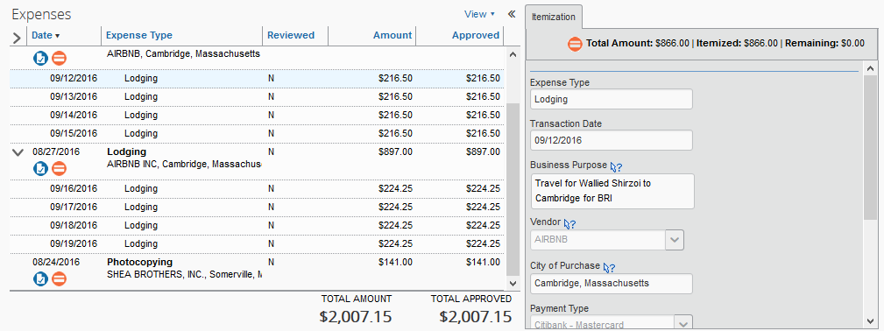
Identified Challenges cont. - Detail Listing
HUID converted to Employee Name of Reimbursee
Line Item Business Purpose
Transaction Date
CoA Coding
Expense Amount
Concur Report Key
Concur Expense Report ID
Transaction Line Description | Tran Date | Tub | Org | Object | Fund | Activity | Sub activity | Root | Transaction Amount Debit or (Credit) | Description 1 | Description 2 | Description 3
Travel for Wallied Shirzoi to Cambridge for BRI | 10/4/2016 | 215 | 17144 | 7652 | 203476 | 238726 | 8 | 13834 | 224.25 | Hall, Alexander Ferrell | 4384 | D8D97C1C7C984A068CA1
Travel for Wallied Shirzoi to Cambridge for BRI | 10/4/2016 | 215 | 17144 | 7652 | 203476 | 238726 | 8 | 13834 | 216.5 | Hall, Alexander Ferrell | 4384 | D8D97C1C7C984A068CA1
Travel for Wallied Shirzoi to Cambridge for BRI | 10/4/2016 | 215 | 17144 | 7652 | 203476 | 238726 | 8 | 13834 | 216.5 | Hall, Alexander Ferrell | 4384 | D8D97C1C7C984A068CA1
Travel for Wallied Shirzoi to Cambridge for BRI | 10/4/2016 | 215 | 17144 | 7652 | 203476 | 238726 | 8 | 13834 | 216.5 | Hall, Alexander Ferrell | 4384 | D8D97C1C7C984A068CA1
Travel for Wallied Shirzoi to Cambridge for BRI | 10/4/2016 | 215 | 17144 | 7652 | 203476 | 238726 | 8 | 13834 | 216.5 | Hall, Alexander Ferrell | 4384 | D8D97C1C7C984A068CA1
Travel for Wallied Shirzoi to Cambridge for BRI | 10/4/2016 | 215 | 17144 | 7652 | 203476 | 238726 | 8 | 13834 | 224.25 | Hall, Alexander Ferrell | 4384 | D8D97C1C7C984A068CA1
Travel for Wallied Shirzoi to Cambridge for BRI | 10/4/2016 | 215 | 17144 | 7652 | 203476 | 238726 | 8 | 13834 | 224.25 | Hall, Alexander Ferrell | 4384 | D8D97C1C7C984A068CA1
Travel for Wallied Shirzoi to Cambridge for BRI | 10/4/2016 | 215 | 17144 | 7652 | 203476 | 238726 | 8 | 13834 | 224.25 | Hall, Alexander Ferrell | 4384 | D8D97C1C7C984A068CA1
J Lerner Business lunch w/Buell to discuss LDM 07.25.16 | 9/30/2016 | 215 | 16920 | 7655 | 1 | 534992 | 1701 | 0 | 25.29 | Lerner, Jennifer | 3255 | 1A4136E2C0084F179C90
J Lerner, Business lunch to discuss LDM Ex ED program, 08.11.16 | 9/30/2016 | 215 | 16920 | 7655 | 1 | 534992 | 1701 | 0 | 114.77 | Lerner, Jennifer | 3255 | 1A4136E2C0084F179C90
8/17/16 Dinner with David Bray to discuss LDM ExEd program | 9/30/2016 | 215 | 16920 | 7655 | 1 | 534992 | 1701 | 0 | 138.53 | Lerner, Jennifer | 3255 | 1A4136E2C0084F179C90
Example:

Slide 10
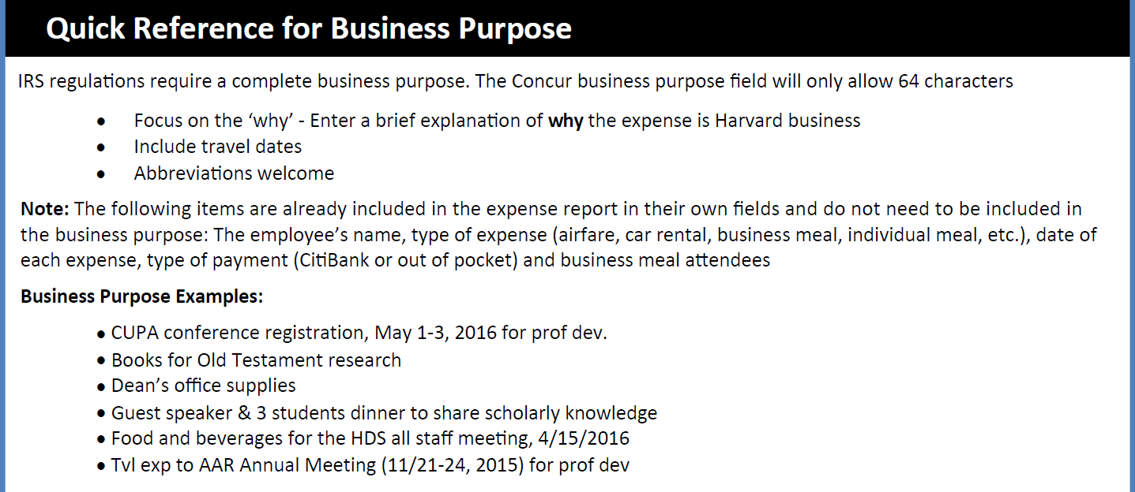
Identified Challenges cont. - 64 Character limit

Slide 11
Example Business Purpose
CURRENT:
6/3/15 B. Student, Registration fee, Inserm Mtg 7/2-3/15 in Nantes, FR; presented poster on research supported by Genetic Engineering/Transgenic Mice grant (156 characters)
CONCUR:
Inserm Mtg, Nantes, FR to present poster on Gen Eng/Transg Mice (64 characters)

Slide 12
NEW OBI – Detail Listing
Potential to add additional fields from Concur as a right click
Travel/Transaction Date
Vendor Name
Example Business Description with added Detail in DL
[Trans date in DL] [Reimbersee Name pulled into DL],[object code - registration fee] Inserm Mtg [travel date pulled in OBI], Nantes, FR to present poster on Gen Eng/Transg Mice

