Slide 1
GMAS Proposal Entry and Proposal Homepage Enhancements
The following screenshots are prototypes and are subject to change prior to the May 2017 release. They also contain fake data (such as dates and names).
These enhancements will only apply to Initial Proposal and Competing Renewal entry and homepages. All other request types and edit screens will still be on old screens after the May 2017 release.

Slide 2
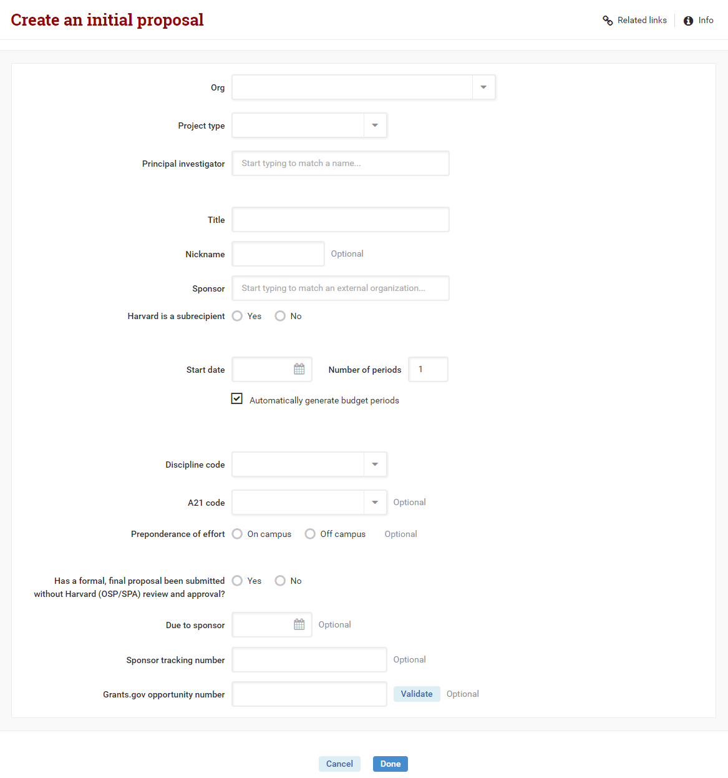
Initial Proposal/Competing Renewal Entry Screen
Proposal entry will be changing from a possible 22 screens to 1

Slide 3
Initial Proposal/Competing Renewal Entry Screen

Slide 4
Streamlined and Smarter
Initial Proposal/Competing Renewal Entry Screen
ORG look-up
Defaults based on security (cannot select an ORG you are not authorized to create requests for)
Drop-down includes look-up for longer lists (can search by number or description)
Principal Investigator look-up/search
Defaults based on security (cannot select a PI you are not authorized to create requests for)
If PI access is not defined by security, field is a person auto-complete look-up that searches all GMAS people
If proposal is a fellowship, security is applied to the Mentor field and the PI field is open to select anyone.
Sponsor look-up
New auto-complete look-up
Prime sponsor/Prime PI
Fields will only show if the user indicates that Harvard is a subaward on the project
Period of performance
Number of periods automatically generate in 12 month increments based on start date and number of periods entered
Budget periods can be overwritten

Slide 5
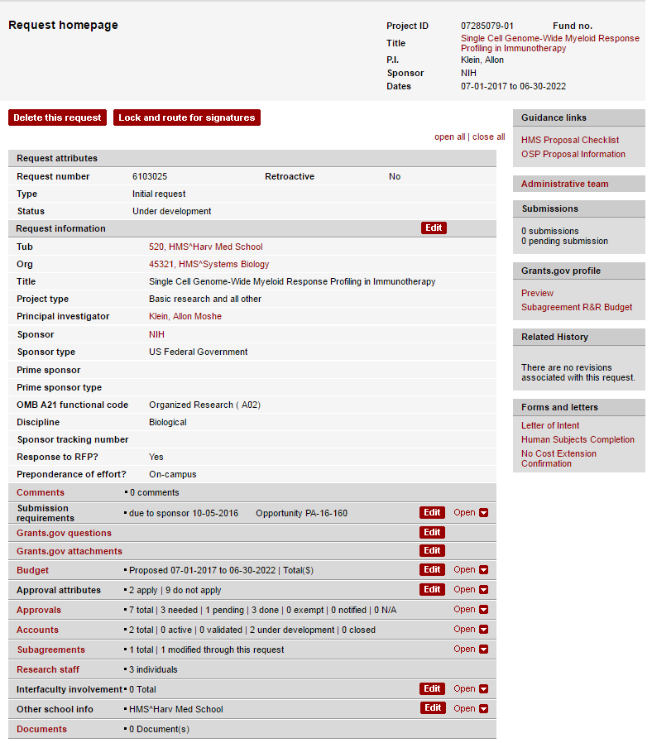
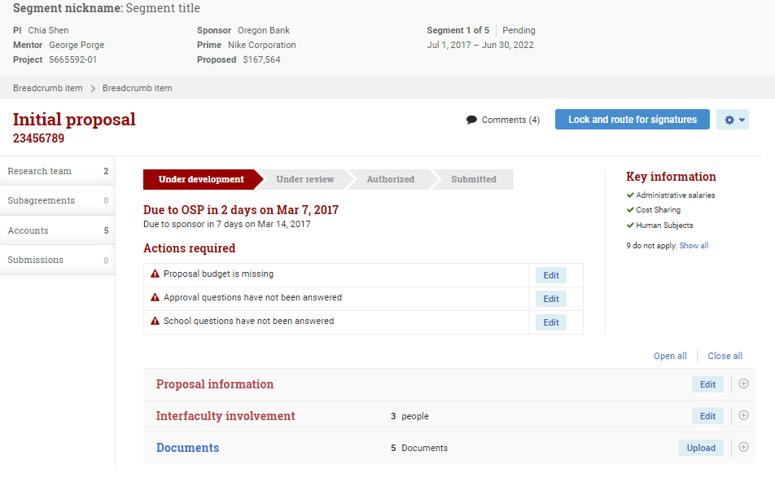
Initial Proposal/Competing Renewal Homepage

Slide 6
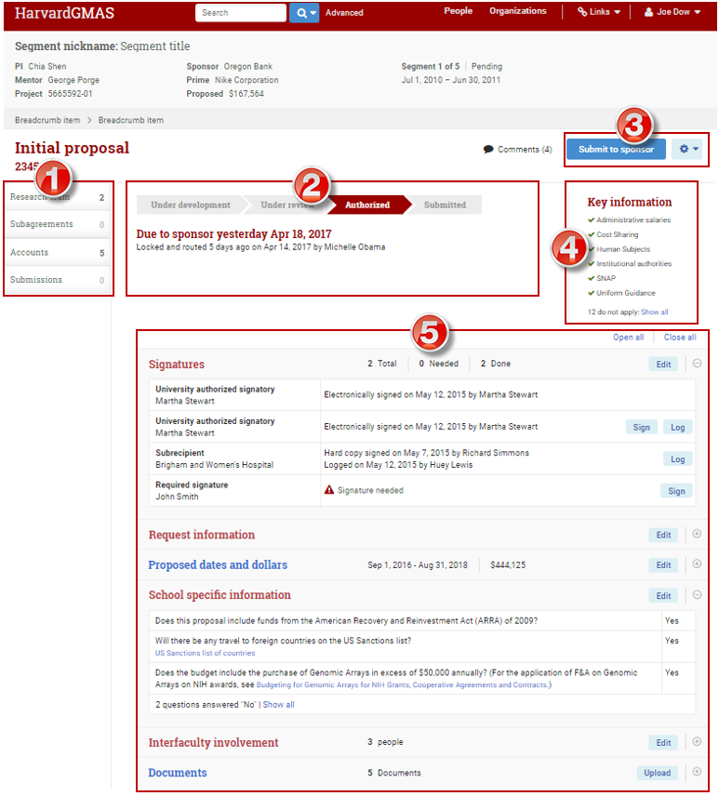
Deconstructing the Initial Proposal/Competing Renewal Homepage
Left Navigation
Links to list screens live here
Status/Workflow Indicator
Provides information relevant to the current state of the proposal
Will list needed actions prior to/preventing routing the proposal for signatures
Action Buttons
Primary action button suggests what the next step in the workflow might be.
Secondary action button lists all other actions available (deleting a request, retracting a request, etc.)
Key Information
Includes answers to approval attribute questions, and if Harvard is a subaward
Panels
Panels will only display when applicable, and will provide summary details in the open view

Slide 7
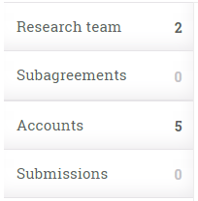
Deconstructing the Initial Proposal/Competing Renewal Homepage
Left Navigation
Link to old list screens

Slide 8
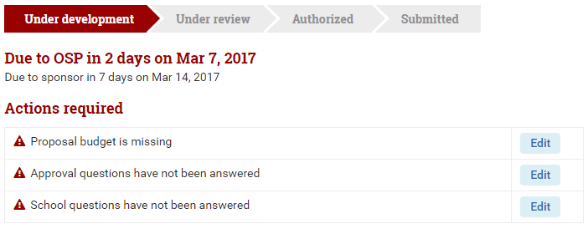
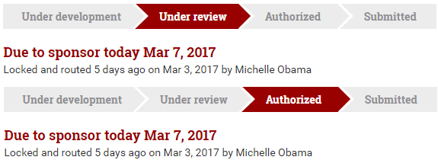
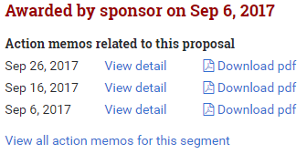
Deconstructing the Initial Proposal/Competing Renewal Homepage
Status/Workflow Indicator
Highlights what day the proposal is due to the central office and sponsor, and missing sections that prevent Lock and route when “Under Development”
Highlights what day the proposal is due to sponsor when “Under Review” or “Authorized”
Highlights submission details when “Submitted”
Highlights associated action memos when “Awarded”
Highlights the reason and who performed the closeout when “Closed”

Slide 9
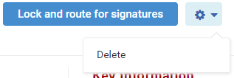
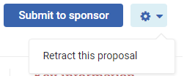
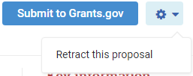
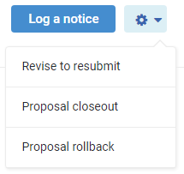
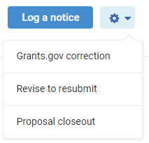
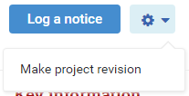
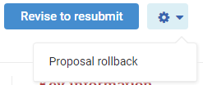
Deconstructing the Initial Proposal/Competing Renewal Homepage
Action Buttons
Under Development:
Lock and route for signature is the next step in the proposal process
Delete is a secondary option
Under Review/Authorized:
Submit to sponsor/Submit to Grants.gov is the next step in the proposal process
Retract (send proposal back to Under Development status) is a secondary option
Submitted to sponsor:
Log a notice is the next step in the proposal process
Revise to resubmit, Request closeout, and request rollback (send proposal back to Under Review or Authorized status) are secondary options
Awarded:
Log a notice is the next step in the proposal process
Make project revision is a secondary option
Closed:
Revise to resubmit is the next step in the proposal process for the most recent proposal submission
Log a notice is the next step in the proposal process for a prior version proposal submission
Request rollback (send proposal back to Submitted to sponsor status) is a secondary option for the most recent proposal submission

Slide 10
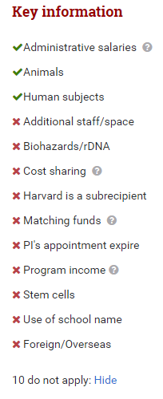
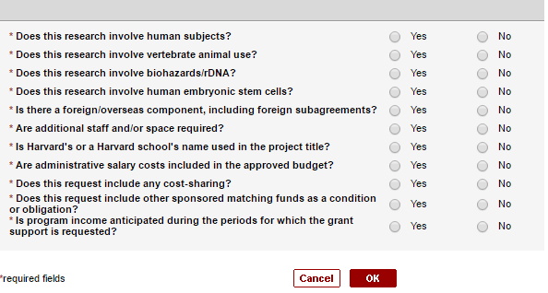
Deconstructing the Initial Proposal/Competing Renewal Homepage
Key Information
All applicable key info will always display with a green checkmark
All key info that does not apply will appear in the hidden portion of the list with a red X
Key information for Initial Proposals and Competing Renewals include the following:
Approval attribute responses
*Note: PI appointment term will only show on proposals entered prior to the May release.
If Harvard is identified as a subaward (if there is a prime sponsor or not)

Slide 11
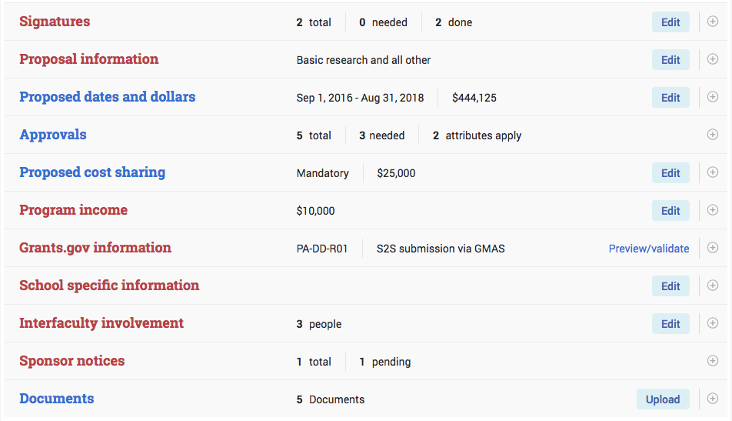
Deconstructing the Initial Proposal/Competing Renewal Homepage
Panels

Slide 12
Deconstructing the Initial Proposal/Competing Renewal Homepage
Panels
The Signatures panel shows for all statuses after Under Development. The summary view in the panel shows all signatures listed as required to sign. The summary view defaults to open when the proposal is in Under Review and Authorized statuses.
The Proposal information panel always shows. The summary view in the panel shows basic information about the request (such as PI name, ORG, etc.)

Slide 13
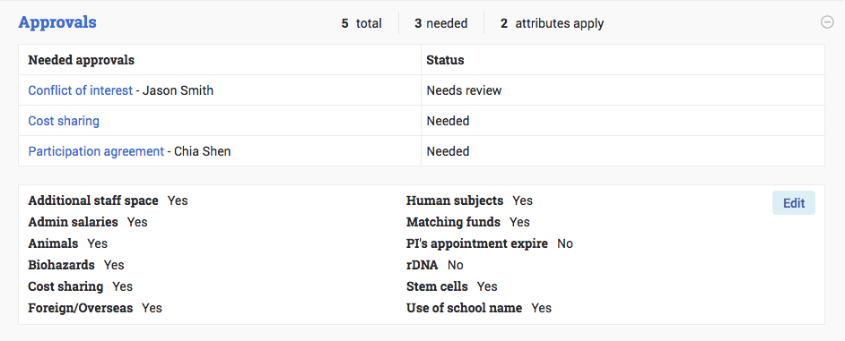
Deconstructing the Initial Proposal/Competing Renewal Homepage
Panels
The Proposed dates and dollars panel shows for all statuses unless the budget information is missing and appears in the “Actions required” section. The summary view in the panel shows each proposed period and the break down of Direct, and Indirect dollars.
The Approvals panel shows once the approval attribute questions have been answered. The summary view in the panel shows the needed approvals and their current statuses, and the approval attribute answers

Slide 14
Deconstructing the Initial Proposal/Competing Renewal Homepage
Panels
The Proposed cost sharing panel only shows if the cost sharing question in approval attributes was answered Yes. The summary view in the panel shows the cost share form details and indicates whether the cost share is Mandatory or Voluntary.
The Program income panel only shows if the program income question in approval attributes was answered Yes. The summary view in the panel shows the break down of program income by period.

Slide 15
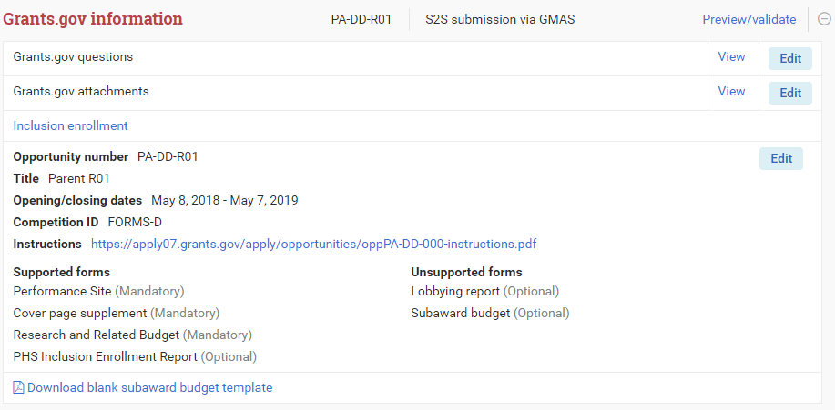
Deconstructing the Initial Proposal/Competing Renewal Homepage
Panels
The Grants.gov information panel only shows if an opportunity number has been validated. The summary view in the panel is where the grants.gov questions, grants.gov attachments, and other submission information can be found.
The School specific information panel shows for all statuses unless the answers are missing and it appears in the “Actions required” section. The summary view in the panel shows the questions that were answered yes with an option to see the full list of questions.

Slide 16
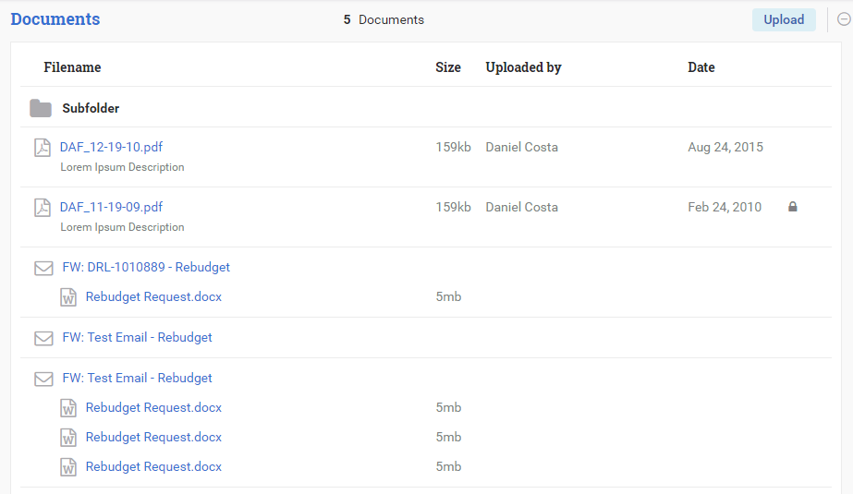
Deconstructing the Initial Proposal/Competing Renewal Homepage
Panels
The Interfaculty involvement panel always shows. The summary view in the panel shows the details of the interfaculty department, PI, and involvement period.
The Documents panel always shows. The summary view in the panel shows all of the documents that have been uploaded into the proposal document repository.

Slide 17
Additional Features for the May Release
30 minute time out increased to 60 minutes
Person profile converted
Document repository panels on all converted screens will now have the option to upload from the panel and have an open component to view all of the documents
For More Information
Visit the GMAS website: http://gmas.fss.harvard.edu/
May Release Updates: https://gmas.fss.harvard.edu/news/gmas-release-144
Job Aids: http://gmas.fss.harvard.edu/user-resources
Blog (don’t forget to sign-up): http://gmas.fss.harvard.edu/blog
Release Notes: http://gmas.fss.harvard.edu/releases
Contact us: contactgmas@Harvard.edu

