Slide 1
GMAS 2.0 Project Update April 2017

Slide 2
May release

Slide 3
Release goals
Shorter and smarter proposal entry
Streamlined proposal home page

Slide 4
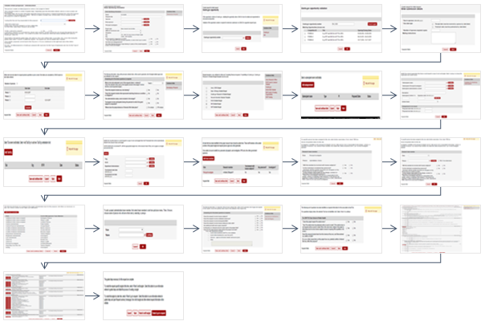
Proposal entry today

Slide 5
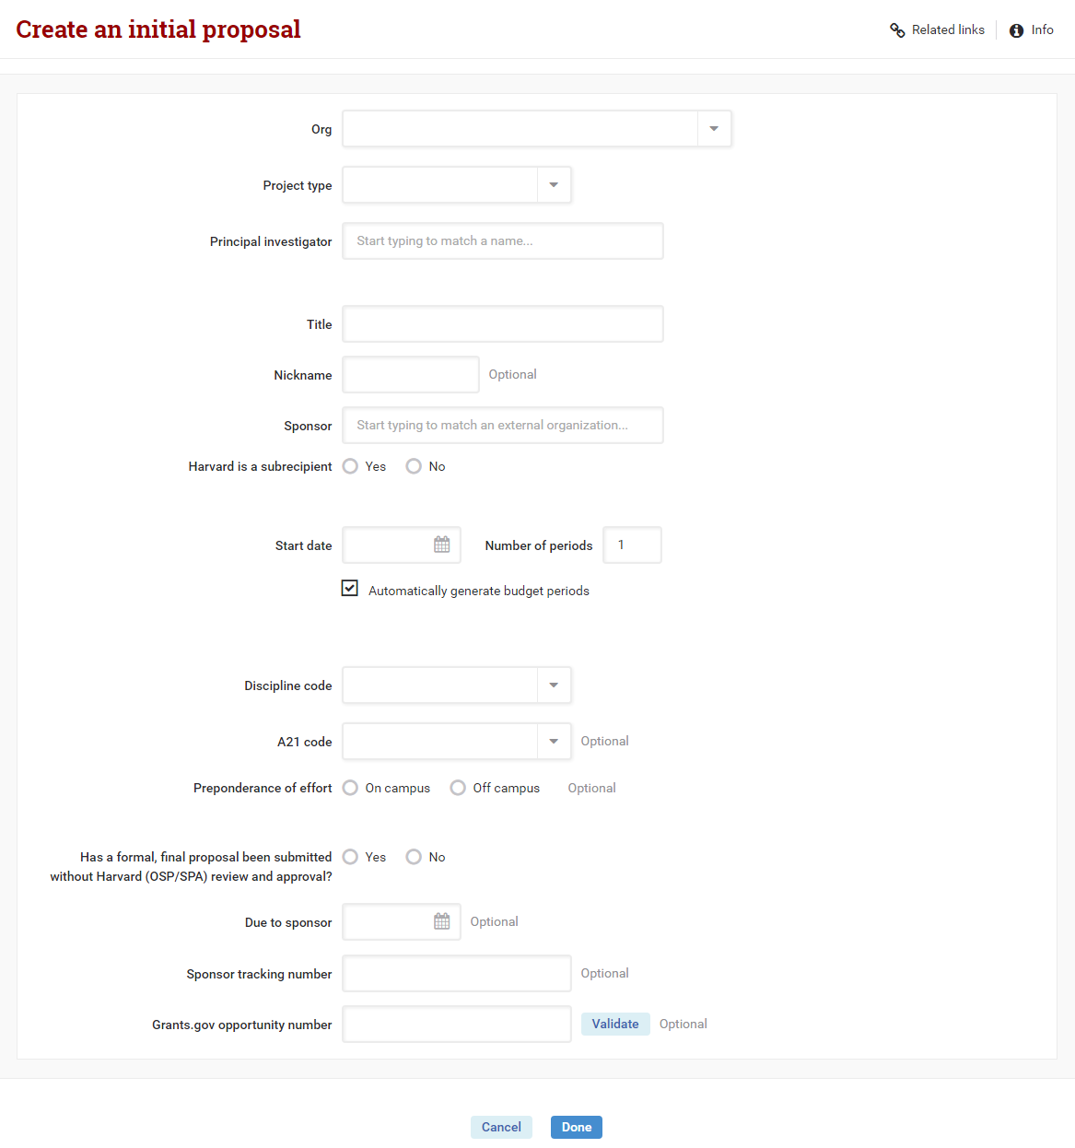
New proposal entry

Slide 6
Proposal entry: key features
Much less data entry is required to enter a new proposal
Research team, approvals, and other data are no longer required, but can be entered later.
Org number and PI are restricted by user security
People won’t be able to create proposals they wouldn’t have access to.
Faster lookups for people and organizations
Autocomplete searches for PI, Mentor, Prime PI, Sponsor, and Prime Sponsor.
Faster date entry
Budget periods default to 12 month increments

Slide 7
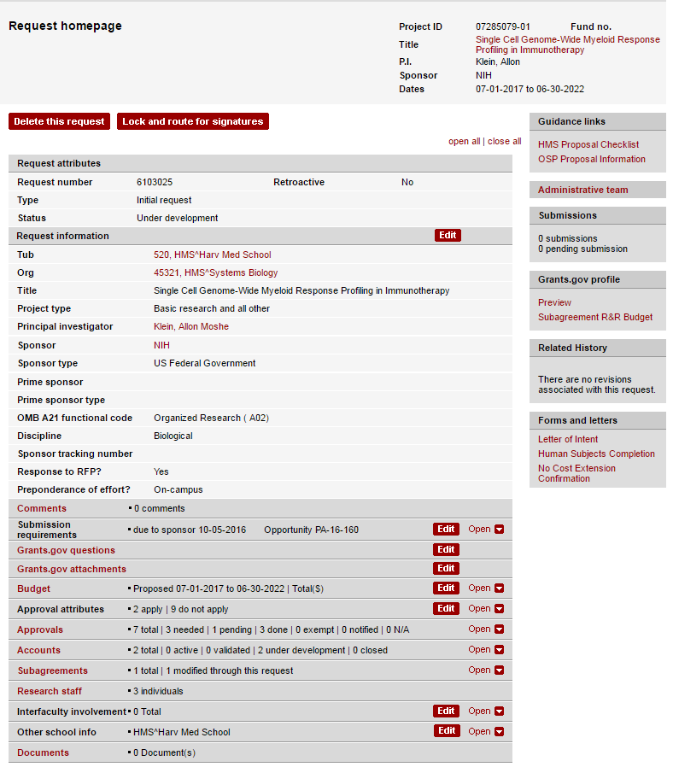
Proposal home page today

Slide 8
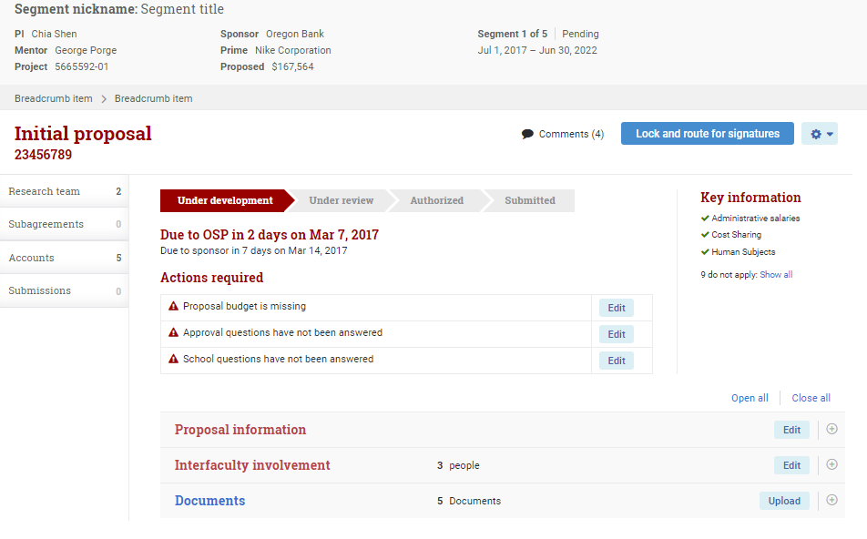
New proposal home page

Slide 9
Proposal home page: key features
Reorganized the page to reduce clutter
Workflow and next steps are highlighted
The page is more dynamic based on proposal status and data

Slide 10
Page conversion for May release
Requests
New proposal creation page
New proposal home page
New proposal edit page
Retired 25 pages from proposal creation and edit proposal
Person
Person profile
Retired 11 pages to edit person details
Notes:
Mix/Match!

Slide 11
DEMO

Slide 12
What’s next

Slide 13
FIRST project
Financial Invoicing and Reporting Strategic Transition
This project has been approved ITCRB funds for FY18
High level project goals:
Replace FRAP system with new GMAS functionality
Improve cash management and financial summary views in GMAS

Slide 14
Where to get more information
GMAS Website http://gmas.fss.harvard.edu
GMAS Blog
http://gmas.fss.harvard.edu/blog
For questions or feedback please email contactgmas@harvard.edu
You can also contact your GMAS business steering committee member with feedback - http://gmas.fss.harvard.edu/gmas-20-business-steering-committee

